Slide 2
There is a disturbance in the space around a magnet called a magnetic field.

Slide 3
Magnetic Fields
Objects can exert forces on each other through a field even though the objects are not in contact
or
Magnetic fields are regions around magnets or electric currents where magnetic forces are exerted on other objects containing magnetic materials. They're represented by lines of force that indicate the direction and strength of the magnetic field.

Slide 4
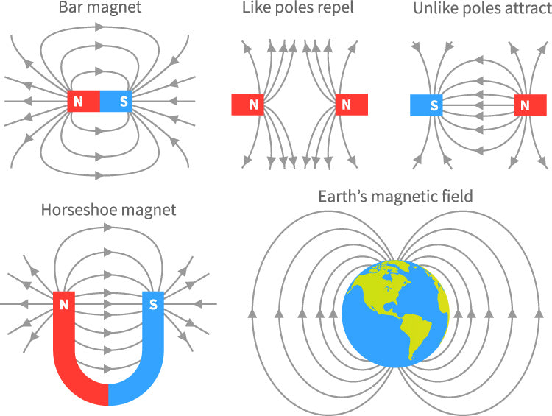
Magnetic Fields

Slide 5
Conduct an investigation to gather evidence that a field exists surrounding a magnet and then create a model that describes a magnet’s magnetic field.
Verify that your lines are correct by quickly moving the compass or probe all around the magnet again.

Slide 6
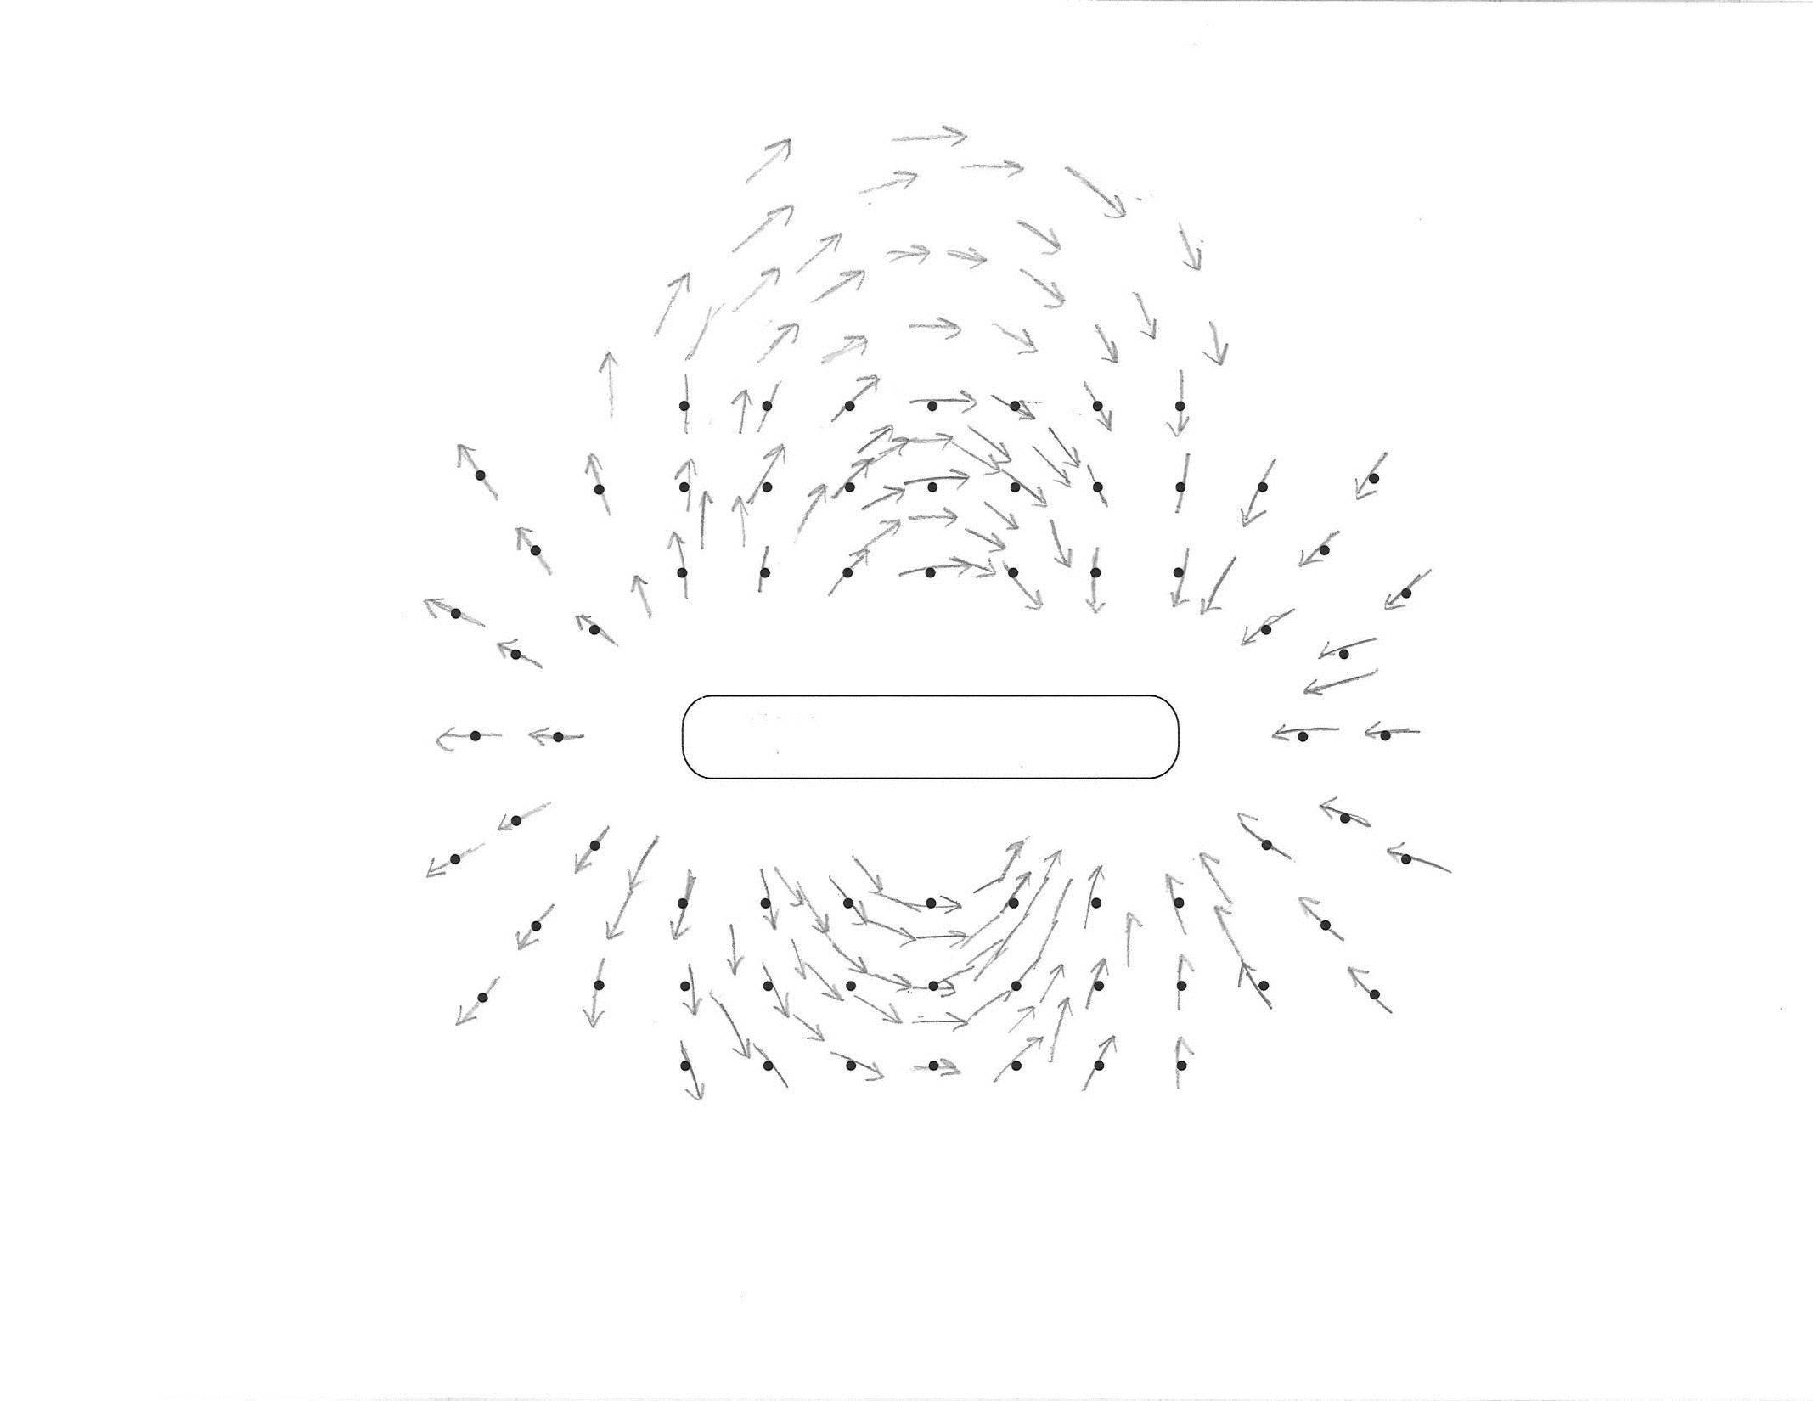
A model of a magnet’s magnetic field

Slide 7
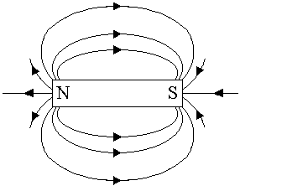
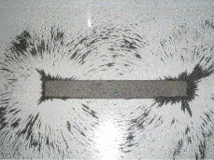
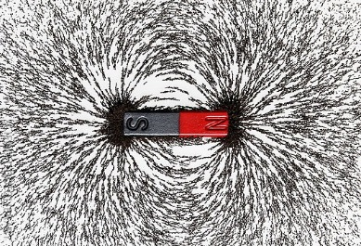

Slide 8
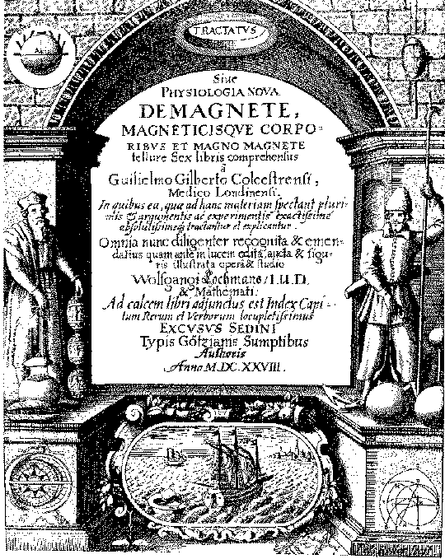
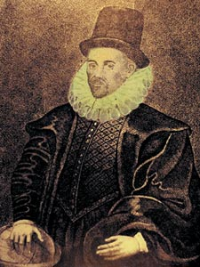
William Gilbert
Conducted investigations on magnetism from about 1581 to 1600
Published results in “De Magnete” in 1600

Slide 9
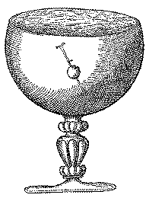
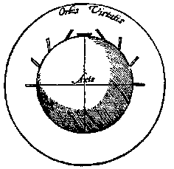
Magnetic Earth
Gilbert observed that when a small compass needle was moved about the surface of a spherical magnet, it faithfully reproduced the behavior of a compass needle on Earth’s surface.
Gilbert's experiments convinced him that Earth itself was a giant magnet.

Slide 10
Reminder from last time:
HOW TO TELL WHICH IS NORTH AND WHICH SOUTH
When a magnet is free to move, the north pole of the magnet will turn around until its north pole is pointing north.
HOW ONE LODESTONE ATTRACTS ANOTHER
The south pole of one magnet attracts the north pole of another, and the north pole attracts the south.
N
S
N
S

Slide 11
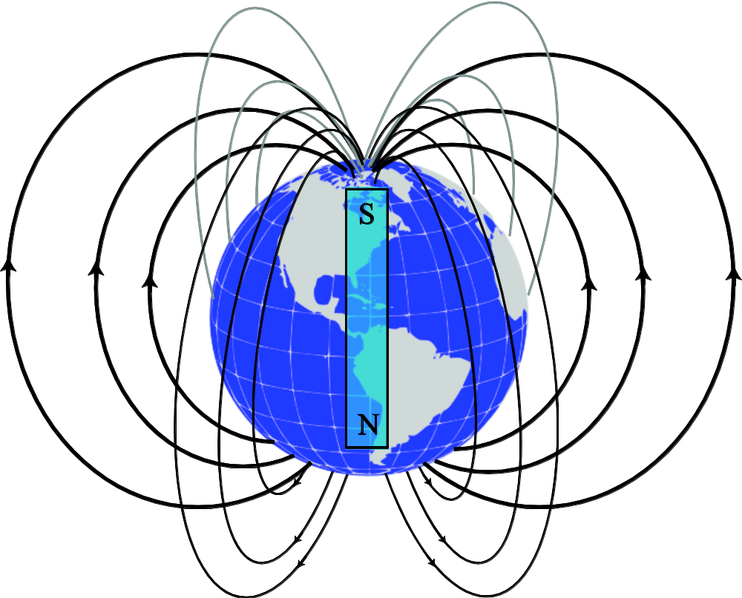
Earth’s Magnetic Field

Slide 12

Magnetism
&
Electromagnetism

Slide 13
Magnetism & electromagnetism
Magnetism is the force exerted by magnets, attracting or repelling other objects made of magnetic materials.
Electromagnetism is a branch of physics that deals with the interaction between electric currents and magnetic fields. It describes how electric currents create magnetic fields and how magnetic fields induce electric currents.

Slide 14
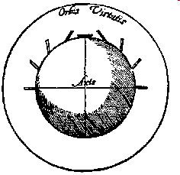
A BRIEF HISTORY
1600 William Gilbert, On magnetism; magnetic materials;
poles that attract & repel; Earth’s magnetic field, compass ‘dip’
1820 Hans Christian Oersted finds that an electric current deflects a compass needle.
1820 Andre Marie Ampère finds that parallel wires
carrying current produce forces on each other.
1820s, 1830s Michael Faraday develops the concept of
electric field and shows that
electric current + magnetism -> motion (motor effect)
motion + magnetism -> electric current (electromagnetic induction)
1860s James Clerk Maxwell (1831-1879) establishes a mathematical description of electromagnetism.

Slide 15
Motors Everywhere
lifts & escalators; fans, turbines, drills; wheelchairs; car windscreen wipers, starter motors, windows & side mirrors; motors in electric cars, locomotives & conveyor belts; industrial robots, saws and blades in cutting and slicing processes; food mixers & blenders, microwave ovens; hand power tools such as drills, sanders, routers; electric toothbrushes, shavers, hairdryers; vacuum cleaners, sound systems, computers …
using electricity supplied by power station generators

Slide 16
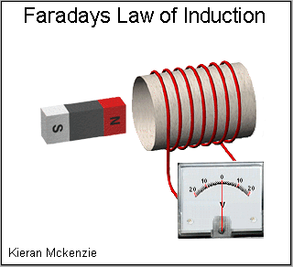
Faraday's law of induction

Slide 17
Faraday's law of induction
Faraday's law of induction states that a changing magnetic field induces an electromotive force (EMF) in a nearby conductor. In simpler terms, it describes how a moving magnetic field can create an electric current in a wire loop or circuit. The induced EMF is proportional to the rate of change of the magnetic flux through the loop.
EMF stands for electromotive force. It's a measure of the energy per unit charge that is generated by a source, such as a battery or a generator, to drive an electric current through a circuit. It's often measured in volts (V).

Slide 18
Faraday's law of induction (or simply Faraday's law) is a law of electromagnetism predicting how a magnetic field will interact with an electric circuit to produce an electromotive force (emf).
This phenomenon, known as electromagnetic induction, is the fundamental operating principle of transformers, inductors, and many types of electric motors, generators and solenoids.
Electromagnetic or magnetic induction is the production of an electromotive force (emf) across an electrical conductor in a changing magnetic field.

Slide 19
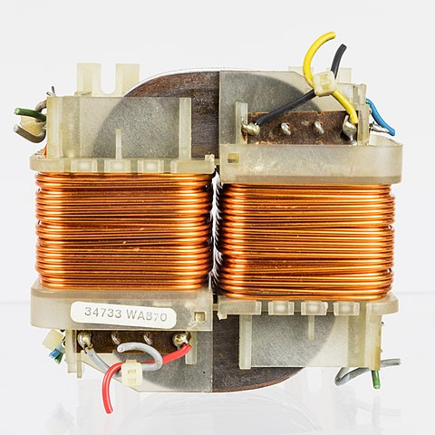
In electrical engineering, a transformer is a passive component that transfers electrical energy from one electrical circuit to another circuit, or multiple circuits. A varying current in any coil of the transformer produces a varying magnetic flux in the transformer's core, which induces a varying electromotive force (EMF) across any other coils wound around the same core. Electrical energy can be transferred between separate coils without a metallic (conductive) connection between the two circuits. Faraday's law of induction, discovered in 1831, describes the induced voltage effect in any coil due to a changing magnetic flux encircled by the coil.

Slide 20
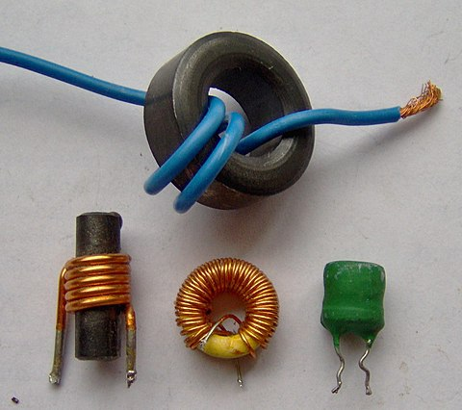
An inductor, also called a coil, choke, or reactor, is a passive two-terminal electrical component that stores energy in a magnetic field when electric current flows through it. An inductor typically consists of an insulated wire wound into a coil.

Slide 21
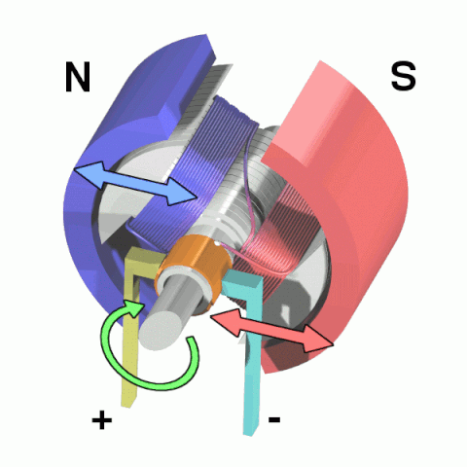
An electric motor is an electrical machine that converts electrical energy into mechanical energy. Most electric motors operate through the interaction between the motor's magnetic field and electric current in a wire winding to generate force in the form of torque applied on the motor's shaft. An electric generator is mechanically identical to an electric motor, but operates in reverse, converting mechanical energy into electrical energy.

Slide 22
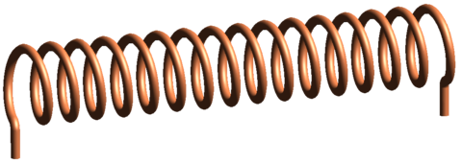
A solenoid is a type of electromagnet formed by a helical coil of wire whose length is substantially greater than its diameter, which generates a controlled magnetic field. The coil can produce a uniform magnetic field in a volume of space when an electric current is passed through it.

Slide 23
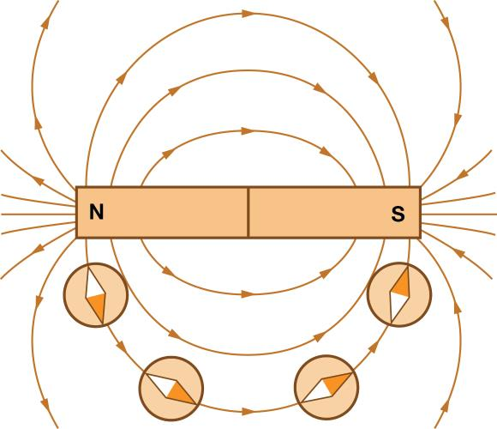
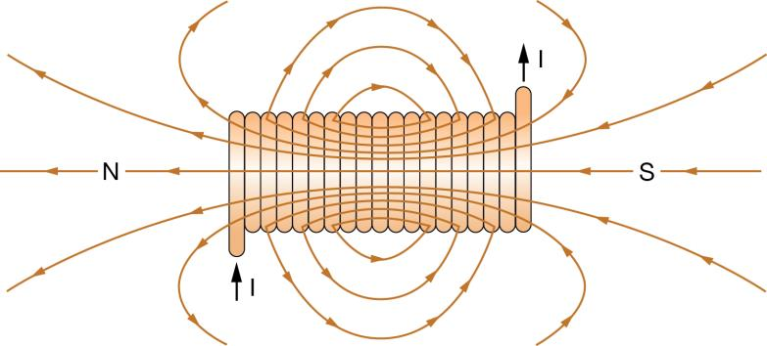
Note the similarity

Slide 24
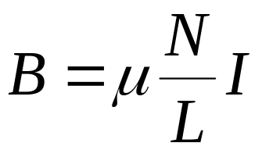
A stronger electromagnet
The length of a solenoid is L
Use iron or steel core (increasing permeability, μ)
Increase the current, I
Increase wraps or turns of a solenoid, N.

Slide 25
Use of Electromagnetism
loudspeaker
moving coil microphone
motors of various designs
electric bell or buzzer (can be made in class, URLS below)
moving coil galvanometer (ammeter)
relay (control circuit with small current switches a second, larger, current circuit)
Practical Physics website: model buzzer, model electric bell

Slide 26
Lenz’s law
Lenz's law states that the direction of the electric current induced in a conductor by a changing magnetic field is such that the magnetic field created by the induced current opposes changes in the initial magnetic field. It is named after physicist Emil Lenz, who formulated it in 1834

Slide 27
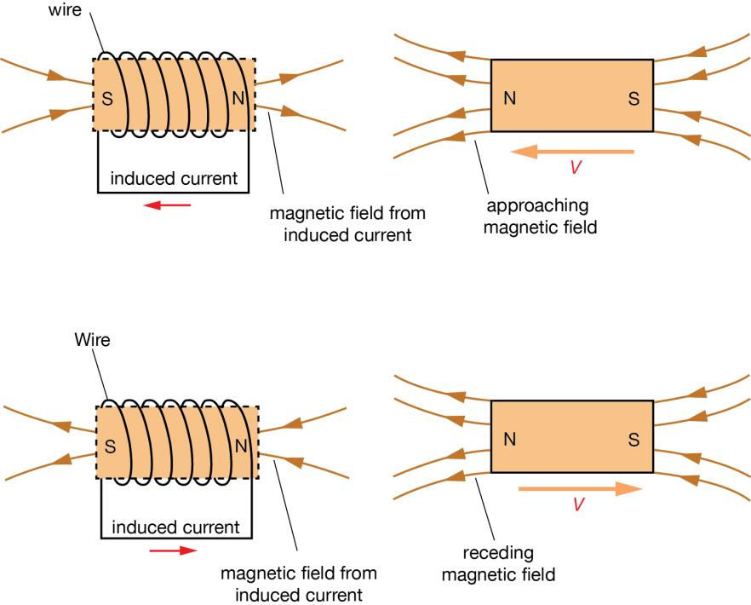
Lenz’s law illustrated

Slide 28
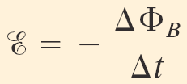
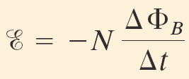
Faraday’s law of induction:
[1 loop]
(on formula sheet)
[N loops]

